Slide 1
Descriptive Statistic Analysis: Collecting, Presenting, and Analyzing Quantitative Data
Research Methodology and Scientific Writing
Faculty of Computer Science, University of Indonesia
Oct 2019
Disampaikan oleh:
Tim Pengajar MPPI

Slide 2
Pengantar…
Salah satu komponen penelitian adalah data, disamping permasalahan dan penyelesaian masalah secara sistematis (metodologi).
Data mesti dikumpulkan secara objective (tidak boleh subjective) dengan instrument tertentu.
Data ada yang bersifat kuantitatif dan/atau kualitatif.
Penelitian kuantitatif menggunakan data yang bersifat kuantitatif.

Slide 3
Discussion
Understanding Quantitative Research
Source of Data
Types of Data
Parametric vs. Non-Parametric Statistics
Validity vs. Reliability
Collecting and Presenting Quantitative Data
Analyzing Quantitative Data

Slide 4
Quantitative Research: Definition (Source: Wikipedia)
In sociology, quantitative research refers to the systematic empirical investigation of social phenomena via statistical, mathematical or computational techniques.^{[1]}
The objective of quantitative research is to develop and employ mathematical models, theories and/or hypotheses pertaining to phenomena.
Intinya, data kuantitatif adalah data empiris hasil dari suatu pengamatan (bisa hasil survey, hasil experiment, hasil observasi, dll.)

Slide 5
The process of measurement is central to quantitative research because it provides the fundamental connection between empirical observation and mathematical expression of quantitative relationships.
Quantitative data is any data that is in numerical form such as statistics, percentages, etc.^{[1]}

Slide 6
In layman's terms, this means that the quantitative researcher asks a specific, narrow question and collects a sample of numerical data from participants to answer the question.
The researcher analyzes the data with the help of statistics.
The researcher is hoping the numbers will yield an unbiased result that can be generalized to some larger population.

Slide 7
Source of Data
Source of data
Quantitative Analysis
Qualitative Analysis
Quantitative
(numerical)
Qualitative
(categorical)
Discrete
Continuous
Discrete

Slide 8
What Is Quantitative Data? (Source: http://study.com/academy/lesson/what-is-quantitative-data.html, March 2016)
What's the difference between having seven apples and saying that they are delicious?
We can count or measure the seven apples, but…
We can't put a number to how delicious they are. Those apples might be delicious to one person and be completely sour to another person.
Saying you have seven apples, because they can be represented numerically, is a piece of quantitative data. But saying that they are delicious is not because you can't write that using numbers.
There are two types of data that quantitative data covers: can be counted and can be measured.

Slide 9
Quantitative or Numerical Data
Discrete Data
Only certain values are possible (there are gaps between the possible values).
Continuous Data
Theoretically, any value within an interval is possible with a fine enough measuring device.

Slide 10
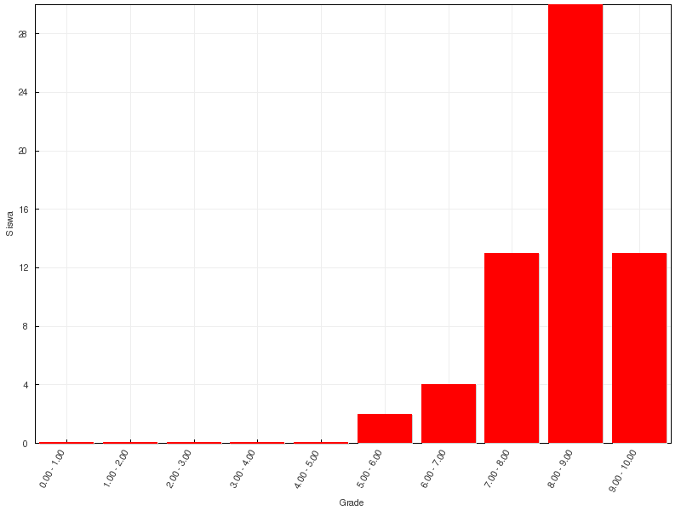
Example of Discrete Quantitative Data
Frekuensi
Nilai Quiz 1 MPPI 2016

Slide 11
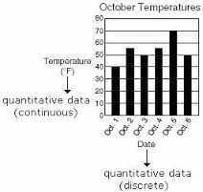
Example of Continuous & Quantitative Data

Slide 12
Continuous and Discrete (End of citing from http://changingminds.org/explanations/research/measurement/types_data.htm)
Continuous measures are measured along a continuous scale which can be divided into fractions, such as temperature. Continuous variables allow for infinitely fine sub-division, which means if you can measure sufficiently accurately, you can compare two items and determine the difference.
Discrete variables are measured across a set of fixed values, such as age in years (not microseconds). These are commonly used on arbitrary scales, such as scoring your level of happiness, although such scales can also be continuous.

Slide 13
Types of Data
Primary data: data observed and recorded or collected directly from respondents.
Data diperoleh secara langsung dari objek pengamatan.
Secondary data: data complied both inside and outside the organization for some purpose other than the current investigation.
Data diperoleh dari sumber lain seperti buku laporan, artikel, dll. Sipeneliti tidak secara langsung melakukan pengamatan kepada objek penelitian.
Kedua jenis data tersebut dapat digunakan sebagai data penelitian.

Slide 14

Types of Data
Primary
Data Collection
Secondary
Data Compilation
Print or Electronic
Observation
Survey
Experimentation
Basic Business Statistics 10e, 2006 Prentice Hall

Slide 15
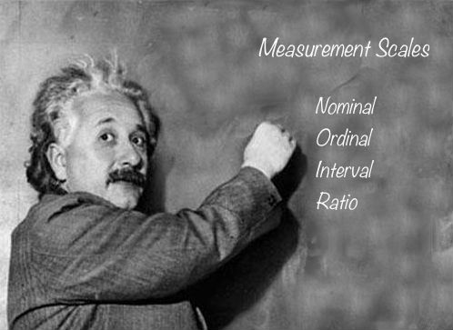

Slide 16
Measurement Scales of Data
Ratio Data
Differences between measurements, true zero exists.
Height, Age, Weekly Food Spending
Interval Data
Differences between measurements but no true zero
Temperature in Fahrenheit, Standardized exam score
Ordinal Data
Ordered Categories (rankings, order, or scaling)
Service quality rating, Standard & Poor’s bond rating, Student letter grades
Nominal Data
Categories (no ordering or direction)
Marital status, Type of car owned
Basic Business Statistics 10e, 2006 Prentice Hall

Slide 17
Nominal Data (Sumber: http://changingminds.org/explanations/research/measurement/types_data.html)
The name 'Nominal' comes from the Latin nomen, meaning 'name' and nominal data are items which are differentiated by a simple naming system.
The only thing a nominal scale does is to say that items being measured have something in common, although this may not be described.
Nominal items may have numbers assigned to them. This may appear ordinal but is not -- these are used to simplify capture and referencing.
Nominal items are usually categorical, in that they belong to a definable category, such as 'employees'.
Nominal scales are used for labeling variables, without any quantitative value. “Nominal” scales could simply be called “labels.”
Example: The number male and female students at Fasilkom, UI, colors of their hair, place of their stay....

Slide 18
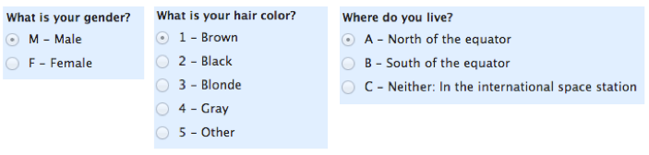
Example of Nominal Data
Simple analysis of the above data, presenting them in bar chart.

Slide 19
Ordinal Data
Items on an ordinal scale are set into some kind of order by their position on the scale. This may indicate such as temporal position, superiority, etc.
The order of items is often defined by assigning numbers to them to show their relative position. Letters or other sequential symbols may also be used as appropriate.
Ordinal items are usually categorical, in that they belong to a definable category, such as '1956 marathon runners'.
You cannot do arithmetic with ordinal numbers -- they show sequence only.
Ordinal scales are typically measures of non-numeric concepts like satisfaction, happiness, discomfort, etc.
Example: The first, third and fifth person in a race; Pay bands in an organization, as denoted by A, B, C and D.

Slide 20
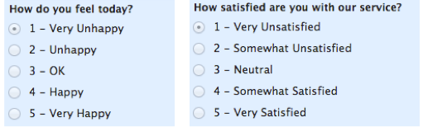
Example of Ordinal Data
How do you analyze above data?

Slide 21
Interval Data
Interval data (also sometimes called integer) is measured along a scale in which each position is equidistant from one another. This allows for the distance between two pairs to be equivalent in some way.
This is often used in psychological experiments that measure attributes along an arbitrary scale between two extremes.
Interval scales are numeric scales in which we know not only the order, but also the exact differences between the values
Interval data cannot be multiplied or divided.
Example
My level of happiness, rated from 1 to 10.
Temperature, in degrees Fahrenheit.

Slide 22
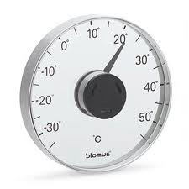
Example of Interval Data
How do you analyze interval data?

Slide 23
Ratio Data
In a ratio scale, numbers can be compared as multiples of one another. Thus one person can be twice as tall as another person. Important also, the number zero has meaning.
Thus the difference between a person of 35 and a person 38 is the same as the difference between people who are 12 and 15. A person can also have an age of zero.
Ratio data can be multiplied and divided because not only is the difference between 1 and 2 the same as between 3 and 4, but also that 4 is twice as much as 2.
Interval and ratio data measure quantities and hence are quantitative. Because they can be measured on a scale, they are also called scale data.
Example: A person's weight; The number of pizzas I can eat before fainting

Slide 24
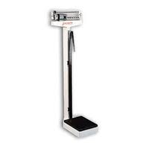
Example of Ratio Data
How do you analyze ratio data?

Slide 25
Categorical data are such that measurement scale consists of a set of categories.
SOME VISUALIZATION TECHNIQUES for categorical data: Jittering, mosaic plots, bar plots etc.
Correlation between ordinal or nominal measurements are usually referred to as association.

Slide 26
Parametric vs. Non-parametric
Interval and ratio data are parametric, and are used with parametric tools in which distributions are predictable (and often Normal).
Nominal and ordinal data are non-parametric, and do not assume any particular distribution. They are used with non-parametric tools such as the Histogram.

Slide 27
Statistics
Parametric Statistics
Parametric statistics is a branch of statistics which assumes that sample data comes from a population that follows a probability distribution based on a fixed set of parameters. Most well-known elementary statistical methods are parametric.
Non-parametric Statistics
Nonparametric statistics are statistics not based on parameterized families of probability distributions. They include both descriptive and inferential statistics.

Slide 28
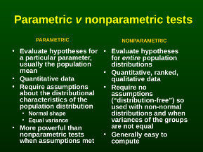

Slide 29
Validity and Reliability
In science and statistics, validity has no single agreed definition but generally refers to the extent to which a concept, conclusion or measurement is well-founded and corresponds accurately to the real world.
In normal language, we use the word reliable to mean that something is dependable and that it will give the same outcome every time.

Slide 30
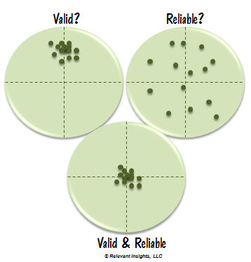
No
No

Slide 31
Diskusi….
Berikan contoh-2 penggunaan data nominal , ordinal, interval, dan ratio dalam bidang Sistem Informasi dan Teknologi Informasi.
Pengolahan statistika apa saja yang sesuai untuk masing-2 data?
Sejauh mana kita bisa menyimpulkan hasil dari berbagai type data tersebut?
Validitas
Reliabilitas

Slide 32
Collecting Data

Slide 33
Collecting Quantitative Data
Identify your unit analysis
Who can supply the information that you will use to answer your quantitative research questions or hypotheses?
Specify the population and sample
Information will you collect
Specify variable from research questions and hypotheses
Operationally define each variable
Choose types of data and measures

Slide 34
Instrument Will You Use To Collect Quantitative Data
Locate or develop an instrument
Search for an instrument
Criteria for choosing a good instrument
Have authors develop the instrument recently, and can you obtain the most recent version?
Is the instrument widely cited by other authors?
Are reviews available for the instrument?
Is there information about the reliability and validity of scores from past uses of the instrument?
Does the procedure for recording data fit the research questions/hypotheses in your study?
Does the instrument contain accepted scales of measurement?

Slide 35
Collecting Quantitative Data
What information you collect?
Observations
Interviews and questionnaires
Documents
Audiovisual materials
Use formalized instrument to collect each information.

Slide 36
Presenting Data

Slide 37
Teknik Penyajian dan Peringkasan Data dan Informasi
Tabel
Teknik Penyajian
Grafik
Ukuran Pemusatan
Peringkasan Data
Ukuran Penyebaran

Slide 38
Example of Table from Quantitative Data
Kategori | Frekuensi | Frekuensi relatif | Persentase
A | 35 | 35/400=0.09 | 9%
B | 260 | 260/400=0.65 | 65%
C | 93 | 93/400=0.23 | 23%
D | 12 | 12/400=0.03 | 3%
Total | 400 | 1 | 100%

Slide 39
Representing Data as Pie Chart
Buat legendnya:
Graphic Pie Chart

Slide 40
Representing Data as Graphs
Graphic Bar Chart

Slide 41
Penyusunan Penyebaran (Distribusi) Frekuensi
Contoh : Data Tinggi Badan (Cm) Dari 50 Orang Dewasa
176 167 180 165 168 171 177 176 170 175
169 171 171 176 166 179 181 174 167 172
170 169 175 178 171 168 178 183 174 166
181 172 177 182 167 179 183 185 185 173
179 180 184 170 174 175 176 175 182 172

Slide 42
Distribusi Frekuensi Tinggi Badan
Interval kelas Frekuensi | Jumlah
164,5 - 167,5 | 6
167,5 - 170,5 | 7
170,5 - 173,5 | 8
173,5 - 176,5 | 11
176,5 - 179,5 | 7
179,5 - 182,5 | 6
182,5 - 185,5 | 5
Jumlah | 50

Slide 43
Frequency Distribution Polygons

Slide 44
Frequency Distribution Bar Chart

Slide 45
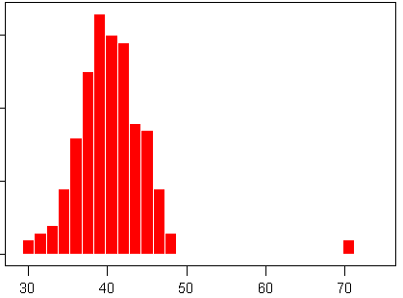
Ukuran Pemusatan relatif sama namun ukuran penyebaran relatif berbeda
Ukuran Pemusatan relatif berbeda namun ukuran penyebaran relatif sama
bimodus
outlier
?

Slide 46
Interpretation…
Dari grafik di atas, kemungkinan sample yang diambil berasal
dari populasi yang berbeda

Slide 47
Analyzing Quantitative Data

Slide 48
The basic quantitative analysis of data use descriptive statistics.
Descriptive statistics describe the basic features of the data in a study. They provide simple summaries about the sample and the measures. Together with simple graphics analysis, they form the basis of virtually every quantitative analysis of data.

Slide 49
Analyze Quantitative Data
Describe trends in the data to a single variable or question on your instrument.
We need Descriptive Statistics that indicate:
general tendencies in the data mean, median, mode,
the spread of scores (variance, standard deviation, and rang),
or a comparison of how one score relates to all others (z-scores, percentile rank).
We might seek to describe any of our variables: independent, dependent, control or mediating.

Slide 50
Histogram – Mengukur Distribusi
Miring
Ke KANAN
Miring
Ke kiri
SIMETRIK

Slide 51
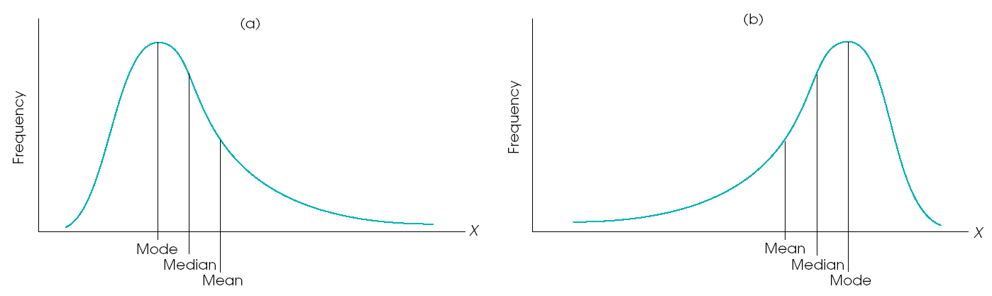
Kaitan Antara Distribusi dengan Ukuran Pemusatan
Mean = Median = Mode

Slide 52
Analyze Quantitative Data
Compare two or more groups on the independent variable in terms of the dependent variable.
We need inferential statistics in which we analyze data from a sample to draw conclusions about an unknown population → involve probability.
We assess whether the differences of groups (their means) or the relationships among variables is much greater or less than what we would expect for the total population, if we could study the entire population.

Slide 53
Analyze Quantitative Data
Relate two or more variable.
We need inferential statistics.
Test hypotheses about the differences in the groups or the relationships of variables.
We need inferential statistics.

Slide 54
Pengujian Hipotesis
Hipotesis satu arah
H0 : μ ≥ μ₀ vs H1 : μ < μ₀
H0 : μ ≤ μ₀ vs H1 : μ > μ₀
Hipotesis dua arah
H0 : μ = μ₀ vs H1 : μ ≠ μ₀
Statistik uji:
Jika ragam populasi (σ²) diketahui :
Jika ragam populasi (σ²) tidak diketahui :

Slide 55
Thank You

